Slide 1



Cardiac Scan
A Non-contact and Continuous Heart-based User
Authentication System
Presenter: Feng Lin
Chen Song, Yan Zhuang, Wenyao Xu, Changzhi Li, and Kui Ren
Notes:
Good morning everyone. I am Feng Lin from University of Colorado Denver, and I will be presenting to you Cardiac Scan, a non-contact and continuous authentication system based on heart motion. This work is completed when I was working in SUNY Buffalo, together with my colleagues Wenyao, Kui also from SUNY Buffalo, and Changzhi from Texas Tech University.

Slide 2
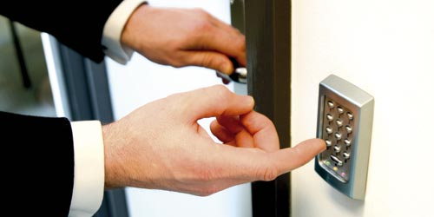
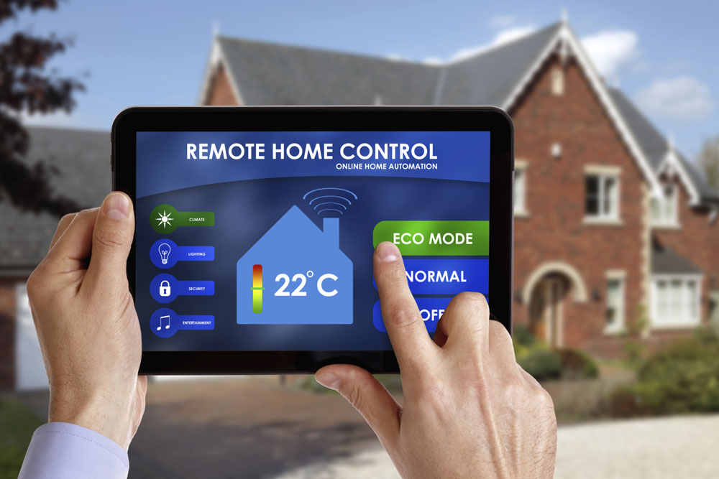


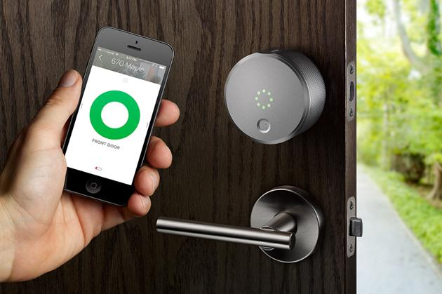
Authentication: Pervasive and Ubiquitous
Notes:
Nowadays, with the booming development of smart devices and Internet of Things, authentication is pervasive and ubiquitous in our life with the applications in door access, smartphone, laptop, smart lock, and smart home.

Slide 3

Vulnerability in one-pass authentication
Absent
Overwhelmed
Notes:
Though the existing one-pass authentication system can protect the legal access in some extent, there is unneglectable vulnerability in the one-pass authentication, especially when the legitimate user is away from the system or is forcibly taken over.

Slide 4



Continuous Authentication
Continuously verify user’s identity
Initial authentic user
Current user
Notes:
Continuous authentication provides potential solutions to improve the above vulnerable one-pass validation by continuously verifying the user's identity during session use, even long after the initial verification. Ultimately, it can guarantee the system is operated by the same user who is initially authorized to log into the system.

Slide 5


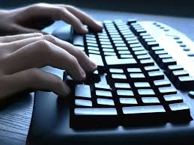
Existing solutions do not work
Neither applicable or usable
Vulnerable to spoofing
Face
Fingerprint
Low usability
Password
Keystroke dynamics
Gaze pattern
Notes:
Existing solutions do not work for continuous authentication. Some are vulnerable to spoofing or replay attacks, such as face recognition and fingerprint. While some other traditional methods are not user-friendly, which demand the user to intentionally engage with the authentication system, such as key in a password every certain period or look at the screen continuously.

Slide 6

Our Solution
Non-contact and
Heart-based Authentication
Notes:
So our solution is non-contact and heart-based authentication.

Slide 7
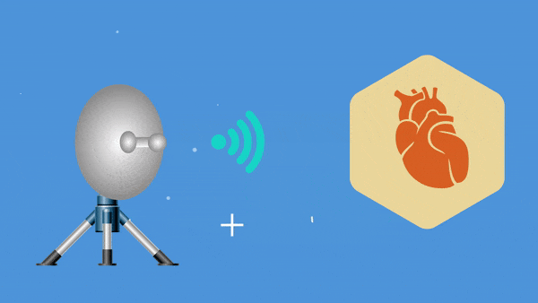
Key Idea of Our Solution
Notes:
Cardiac Scan transmits a radio signal towards the heart and receives the reflections bounded back. It can capture the heart geometric information.

Slide 8
Why Cardiac Motion a unique identity?
Notes:
One natural question is “Why cardiac motion can be a unique identity?”

Slide 9
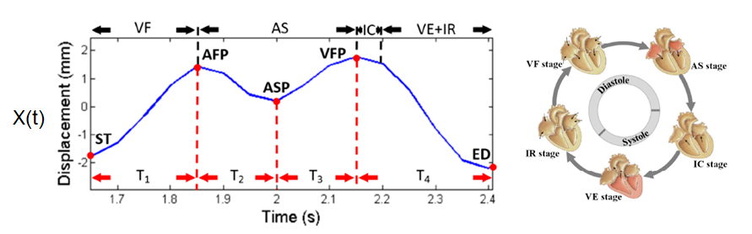
Why Cardiac Motion a unique identity? (1)
Cardiac Motion to Amplitude Mapping
3D automatic heart deformation caused by the self-excitement of the cardiac muscle
Fiducial Points: AFP, ASP, and VFP
Diastole: Relaxation Systole: Contraction
Notes:
First, cardiac motion is a 3D automatic heart deformation caused by the self-excitement of cardiac muscle. Basically, a complete cardiac cycle includes five stages. Among those stages, three stages IR, VF, AS are considered as heart relaxation. And the rest two stages VE, IC are the heart contraction. These relaxation and contraction periods correspond to the peak and valley points in displacement signal xt, socalled fiducial points.

Slide 10
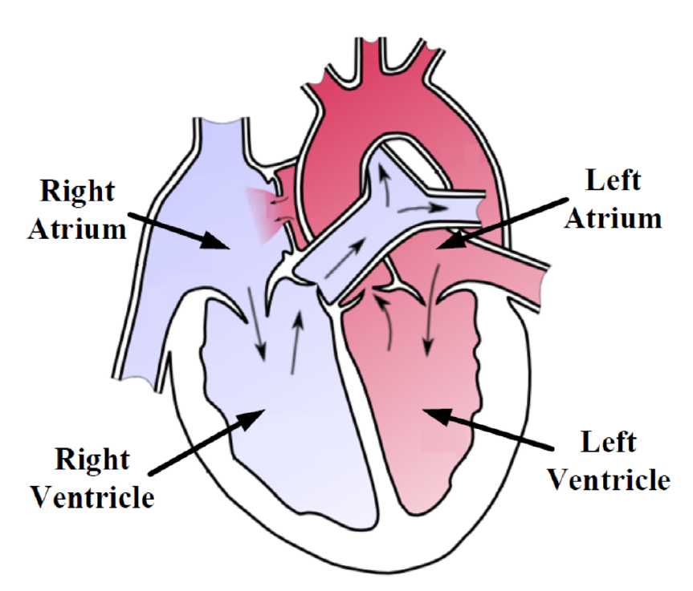
Why Cardiac Motion a unique identity? (2)
Heart Geometry Difference
Volumes
1
Surface Shape
2
No two persons have the same heart structure and related muscle and tissues[1].
[1] M. Carlsson, P. Cain, C. Holmqvist, F. Stahlberg, S. Lundback, and H. Arheden, “Total heart volume variation throughout the cardiac cycle in humans,” American Journal of Physiology-Heart and Circulatory Physiology, vol. 287, no. 1, pp. H243–H250, 2004.
Notes:
From the biology point of view, no two people have the same heart structure and related muscle and tissues. As we can see our heart has right Atrium, right Ventricle, and left Atrium, left Ventricle. They are geometrically different in terms of volumes and surface shape.

Slide 11

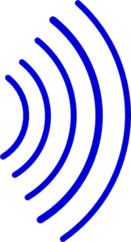

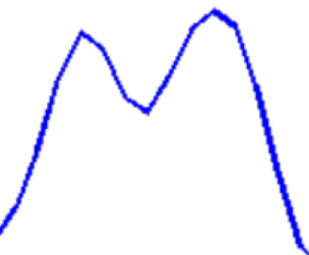
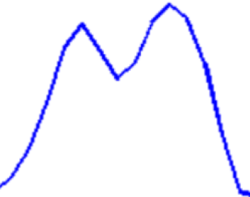
Why Cardiac Motion a unique identity? (3)
Geometry Information Acquisition
Right Atrium
Right Ventricle
Left Atrium
Left Ventricle
Left Atrium Contraction
Right Atrium Contraction
Volume
Surface Shape
Left Ventricle Expansion
Right Ventricle Expansion
Multiple Direction Sensing
Notes:
To capture heart geometry information, we deployed multiple radars around a user enabling sensing from different direction simultaneously, each radar will capture different atrium and ventricle vibration from different angle, such that heart displacement signals reflecting different Atrium and Ventricle’s geometric information can be captured.

Slide 12
Is cardiac motion biometrics affected by the heart rate variation?

Slide 13
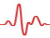
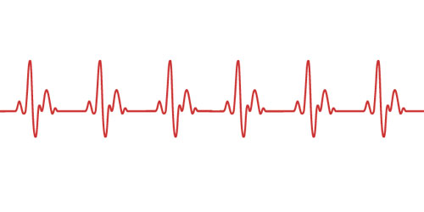
The answer is :No Main advantage over ECG
1. Heart rate variation only change the interval between each cycle without altering the inner heart geometric information.
Change
Remains
2. Geometric information is kept unchanged inside the cardiac cycle.
Notes:
Here we have two cardiac motion waveform, each contains several cardiac cycles. The top one has faster heart rate than the lower one.

Slide 14
How Cardiac Scan Works
Notes:
So, the rest of this talk is about how our system works.

Slide 15
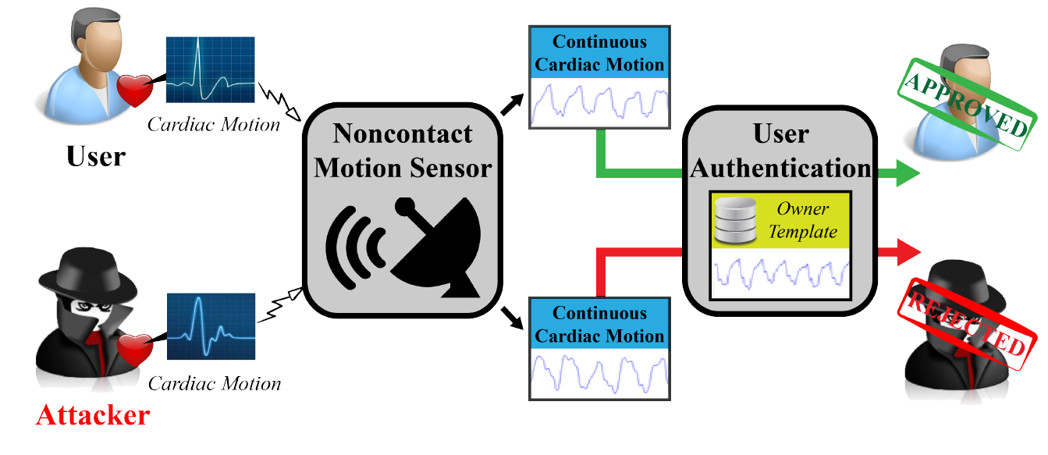
Notes:
The motion sensing radar measures the authentic user’s cardiac motion and such information is stored in the database as the authentication credential. Once the radar captures a cardiac motion information from an unknown user, it compares with the prestored credential to determine whether give the access permission or reject.

Slide 16
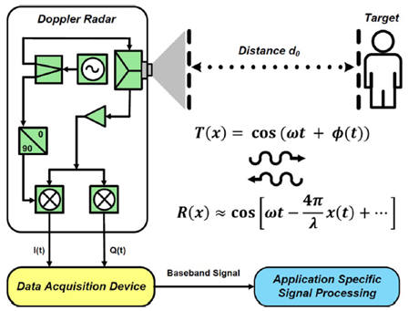
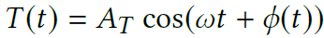
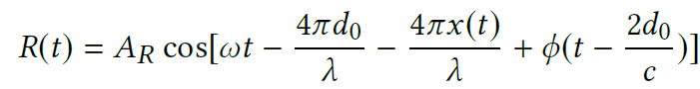
Doppler Radar Sensing
Notes:
The principle of the Doppler radar sensing is shown in the figure. The transmission signal is denoted as tt, because the Doppler effect caused by the cardiac motion, the received signal denoted as rt will contains the component of heart displacement signal xt. After demodulating this signal, later we will extract features from it.

Slide 17
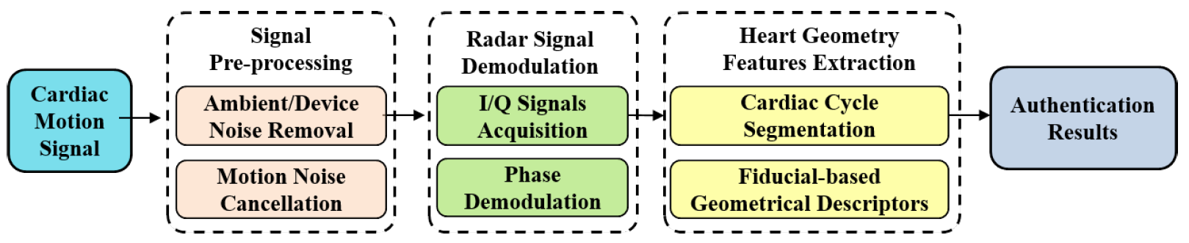
Cardiac Motion Signal Processing
Notes:
The overall cardiac scan signal processing flow which includes three module, signal preproceesing to remove noise, radar signal demodulation, and heart feature extraction.

Slide 18
Challenges:
Interference caused by random body motion
Resilient to spoofing attack
Notes:
In implementing the signal processing, there are 2 major challenges.

Slide 19

Multiple Radar Setting
Opposite Doppler frequency shift
Combine low-speed baseband signal [2][3]
[2] Changzhi Li and Jenshan Lin. 2008. Complex signal demodulation and random body movement cancellation techniques for non-contact vital sign detection. In Microwave Symposium Digest, 2008 IEEE MTT-S International. IEEE, 567–570.
[3] Changzhi Li and Jenshan Lin. 2008. Random body movement cancellation in Doppler radar vital sign detection. IEEE Transactions on Microwave Theory and Techniques 56, 12 (2008), 3143–3152.
Challenge 1: Interference caused by random body motion
Notes:
Challenge 1, to solve the interference caused by random body motion, again, multiple radar setting is employed. Random body motion creates an opposite Doppler frequency shift to the signals of the radars. By properly combining the low-speed baseband signals from the radars, the random body motion signal can be suppressed.

Slide 20
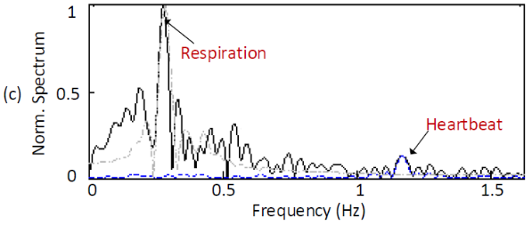
Liveness artifacts:
Respiration Detection
Challenge 2: Resilient to spoofing attack
Notes:
The 2 challenge is how to make the system resilient to replay attack. The anti-spoofing strategy we adopt is liveness artifacts detection. As seen from this spectrum diagram, cardiac scan not only shows the heartbeat signal but also the respiration signal. The replay attack emulating cardiac motion will not contains any respiration signal. As a result, the replay attack can be detected.

Slide 21
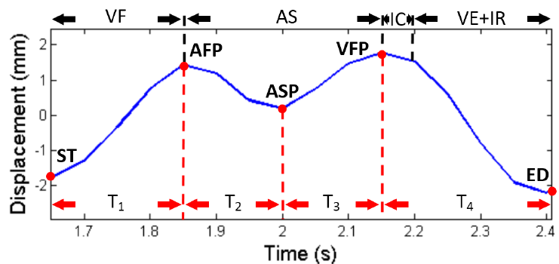
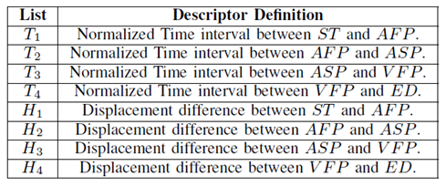
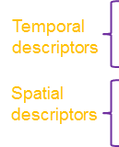
Heart feature extraction and classification
SVM (RBF) is used for classification
Notes:
The next step is heart feature extraction and classification. Based on these fiducial points we discussed before, we can extract temporal descriptors and spatial descriptors from xt, which are the normalized time interval and displacements among these fiducial points.

Slide 22
Performance Evaluation
Notes:
In the following, I will talk about performance evaluation.

Slide 23
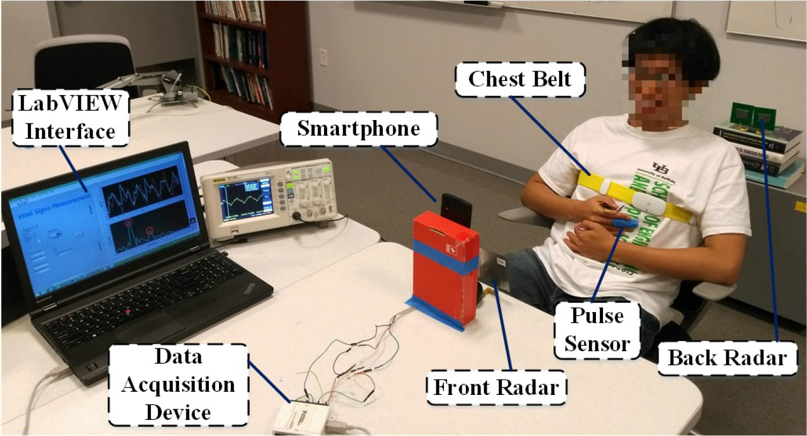
Experimental Setup
78 Participants (46 males and 32 females) with age range of 16-54
Notes:
This is our experimental setup. A subject is sitting on a chair, two radars are placed in front of and behind the subject with the distance of 1 meter each. A pulse sensor and a chest belt is attached on the subject’s finger and chest to provide the reference of heartbeat and respiration.

Slide 24
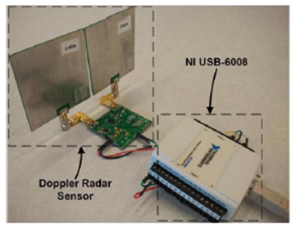
System Parameters
Frequency: 2.4 GHz
Bandwidth 5 KHz
1 TX and 1 RX antenna
Beam width: 45 degree
Power consumption: 650 mw
Acquisition device: NI USB-6008
Pulse sensor: UFI 1010 pulse transducer
Chest belt: UFI 1132 piezo-electric respiration transducer
Notes:
Here list several parameters of our system. The Doppler radar is operated……. the radar has two antenna, one for transmission one for receiving.
the motion information to be detected is only a few Hertz, which means both received signals and transmitted signals are only separated by a few Hertz, while other signals from potential interferences (e.g., WiFi and Bluetooth) have a much higher frequency separation and are conveniently rejected by the baseband signals. In other words, both transmitted signals and received signals are “coherent", whereas other signals are not coherent with transmitted signals.

Slide 25
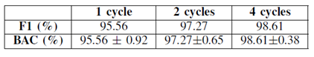
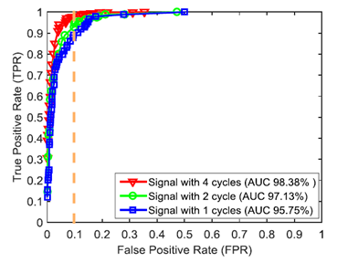
Accuracy
Balanced Accuracy (BAC)
F1
ROC
More than 98% Accuracy
Notes:
To make sure the system is effective in practice, we evaluate the system from multiple aspects. First, we look at the recognition accuracy. In each turn, one user act as the authentic user, and other users are unauthorized user. We also compare the performance with different cardiac cycle. As we can see both the F1 measurement and balanced accuracy can achieve more than 98% with the 4 cycles setting. And the ROC results are consistent with the BAC and F1 measurement.

Slide 26
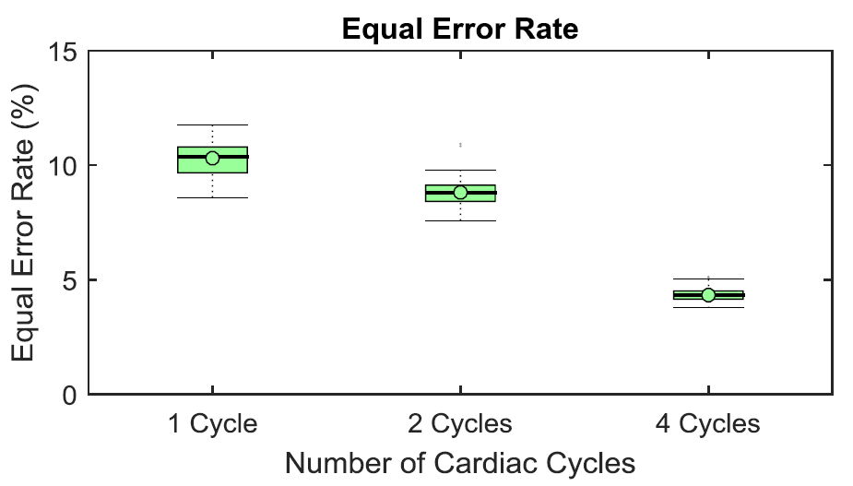
Equal Error Rate (EER)
5% EER
Notes:
The equal error rate can achieve as low as 5%.

Slide 27
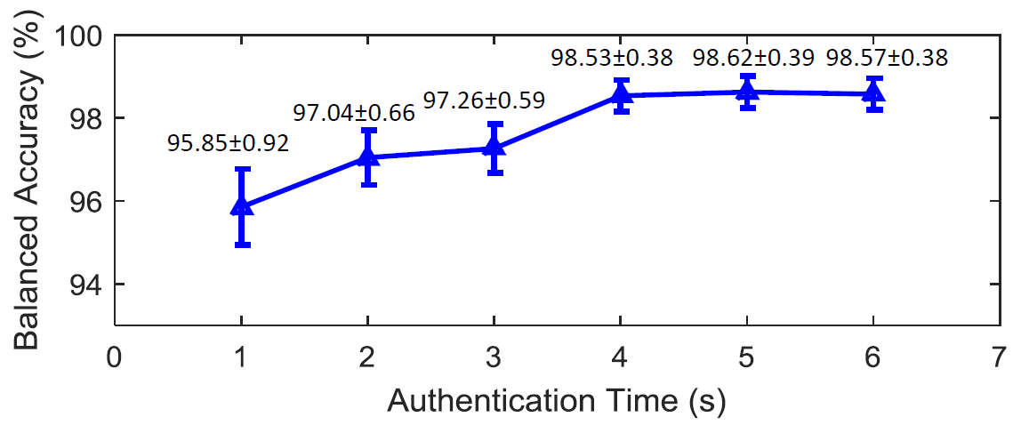
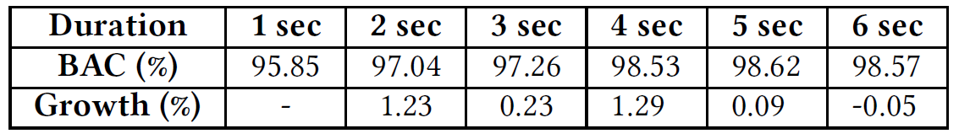
Authentication time
4s Authentication time
Notes:
As a continuous authentiation system, cardiac scan can proactively conduct the authentication without interfereing the user’s work flow. The authentication time will not impact the usabilty, but may birng some system overhead.
Specifically, we define the auth time as the sensing duration + processing duration. We increased the authentication time from 1s to 6s with the step of 1s, and tried to observe the balanced accuracy change. We noticed that the performance is increasing as the authentication time increases until it reaches 4s that the performance became stable. To find the optimal time, we calculated the growth rate. And it seems 4s is a turning point that suggest it is a good authentication time. Our conclusion is the auth time will bring overhead to the system.

Slide 28
Evaluation in Complex Conditions
Notes:
We also evaluate the system in complex conditions.

Slide 29
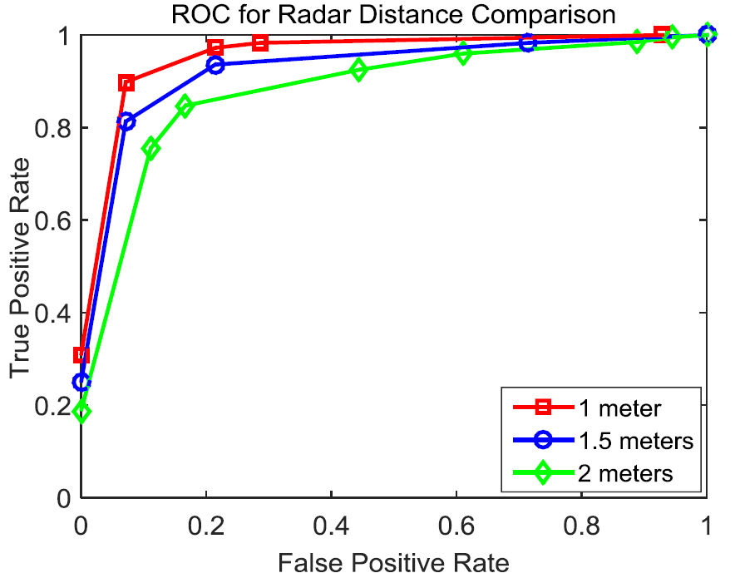

Distance Impact
Amplitude
1/distance
Notes:
First, the distance impact. We found out the closer distance has better performance in terms of ROC curve. This is because the amplitude of the baseband radar I/Q signal is inversely proportional to the distance between the subject and Doppler radar sensor.

Slide 30
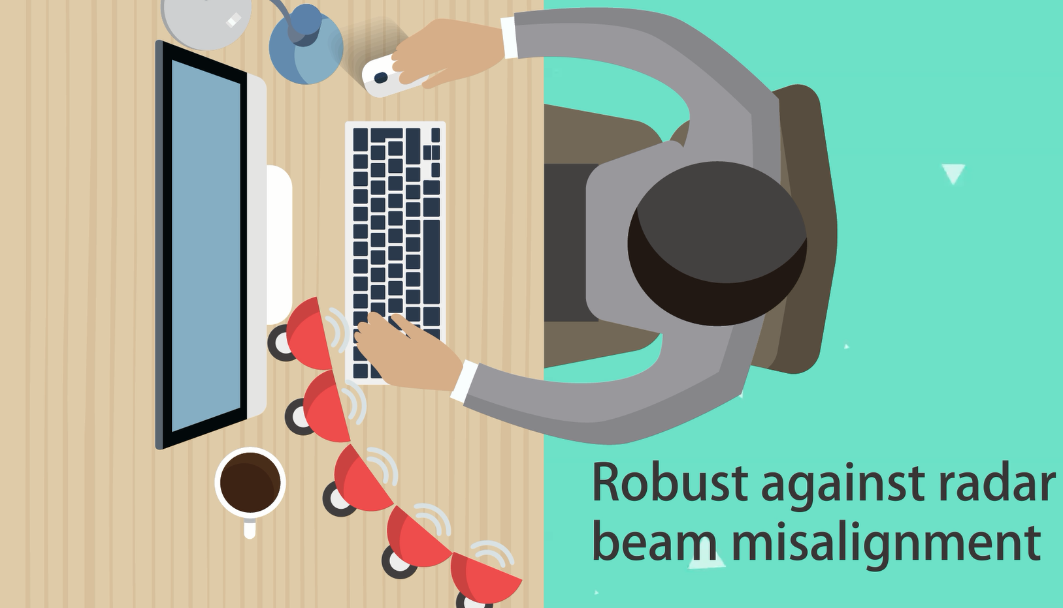
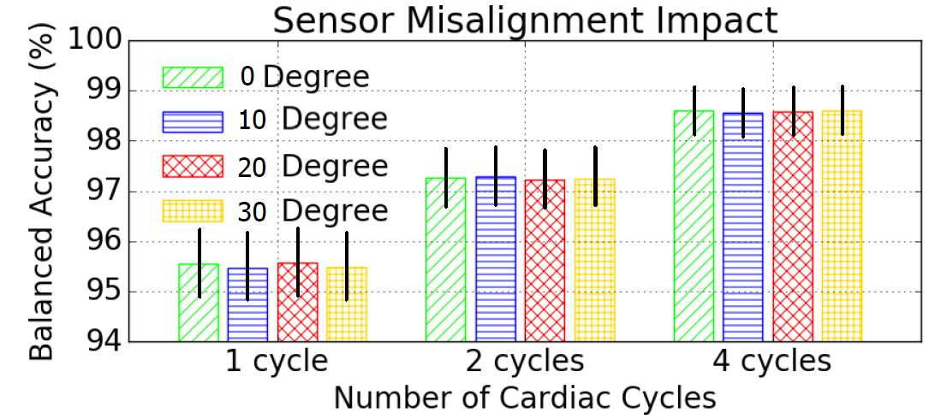
Location Sensitivity
Notes:
Next, is Cardiac Scan sensitive to the location of radar? To answer this question, we have collected a set of cardiac motion signals with a certain degree of orientation misalignment from 10 to 30 degree. We can see the balanced accuracy performance almost remains stable with different degrees of misalignment no matter how many the cardiac cycle is.

Slide 31
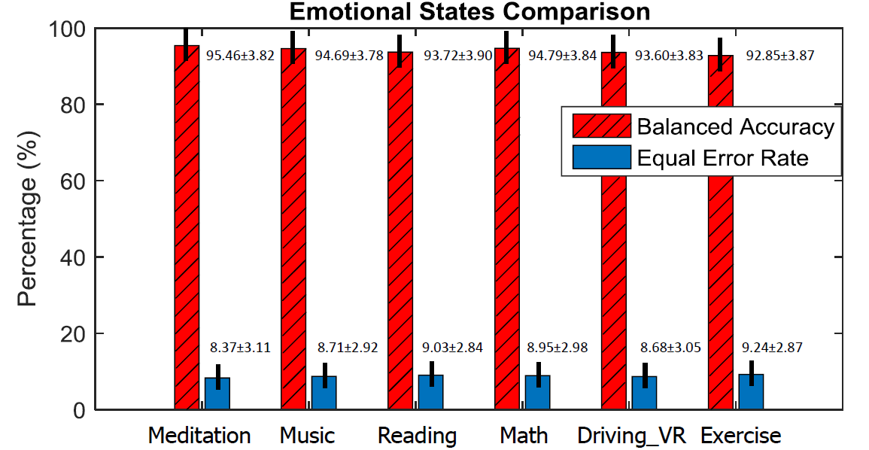
Robust to emotional states
Notes:
To prove our system is insensitive to emotional states, we have conducted a set of experiments examining subjects in different emotional states including Meditation, listening music, reading, doing math, playing the VR driving game, and immediately after exercise. The result show different states almost have the same performance in terms of bac and eer because our method is independent of the heart rate variation.

Slide 32
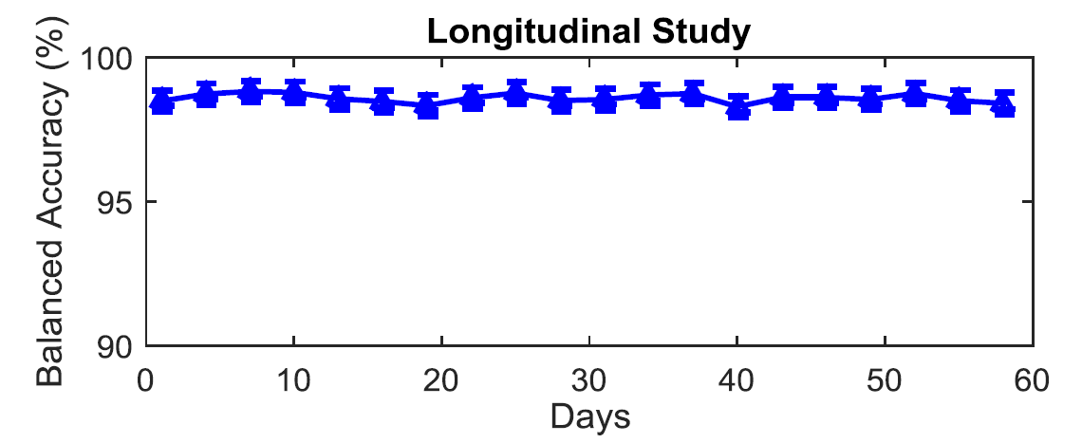
Robust against time change
Notes:
Long term permanence is essential for an authentication system, thus we conducted a longitudinal evaluation. We can see the performance is robust against time change.

Slide 33
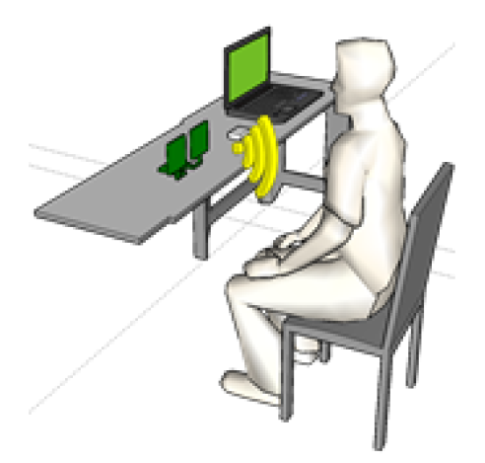
Continuous Authentication Stability
Purpose:
Mis-classify an authentic user as an adversary?
Result:
No authentic user was accidently force to log out
Notes:
As a continuous authentication system, the continuous authentication stability is an important metric. The purpose is to verify whether the system will mis-classify an authentic user as an adversary. The result turns out to be sufficiently good that No authentic user was accidently force to log out.

Slide 34
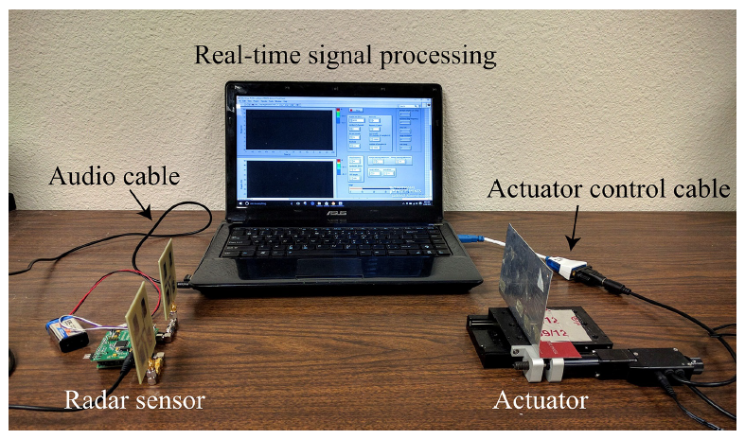
Vulnerability study
Replay attack system setup
12 subjects involved in the anti-spoofing evaluation.
All replay attacks rejected
Notes:
Last, we verify the performance of anti-spoofing. This figure shows the experimental setup for replay attack. a linear actuator were placed 30 cm from the cardiac motion-sensing device. The actuator was programmed to perform a harmonic back-and-forth motion toward the radar for mimicking cardiac motion patterns. 12 subjects participated in the experiment as the authentic user to test the anti-spoofing performance. All replay attacks were rejected due to our anti-spoofing strategy.

Slide 35
Future work
Cardiac arrhythmia
Using a cardiac pacemaker.
Conclusion:
A Non-contact and Continuous Authentication system by measuring cardiac motion.
Notes:
Our future work will involve testing the system with subjects of cardiac diseases or using a cardiac pacemaker. And with this, I will wrap up my talk. We proposed cardiac scan, thank you very much, and I will take any questions.

Slide 36
Thank you!
Q & A

Slide 37
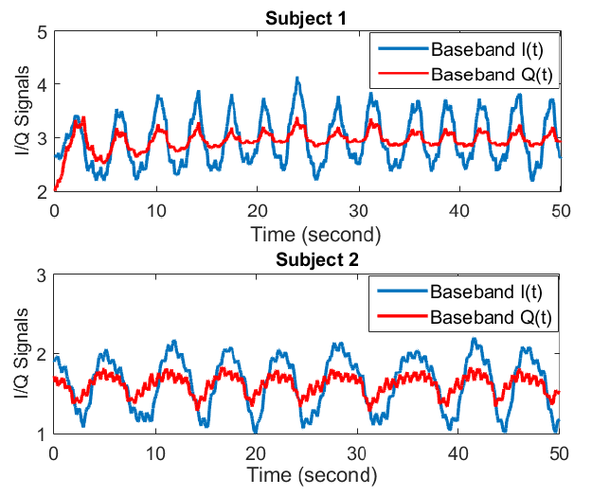
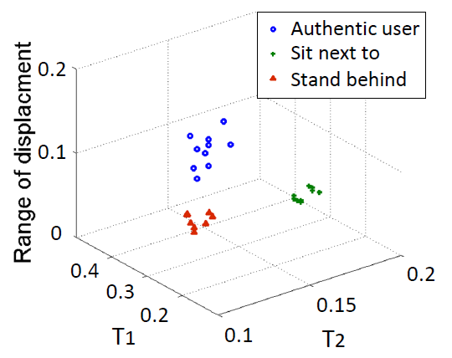
Appendix
Multiple People Detection

Slide 38
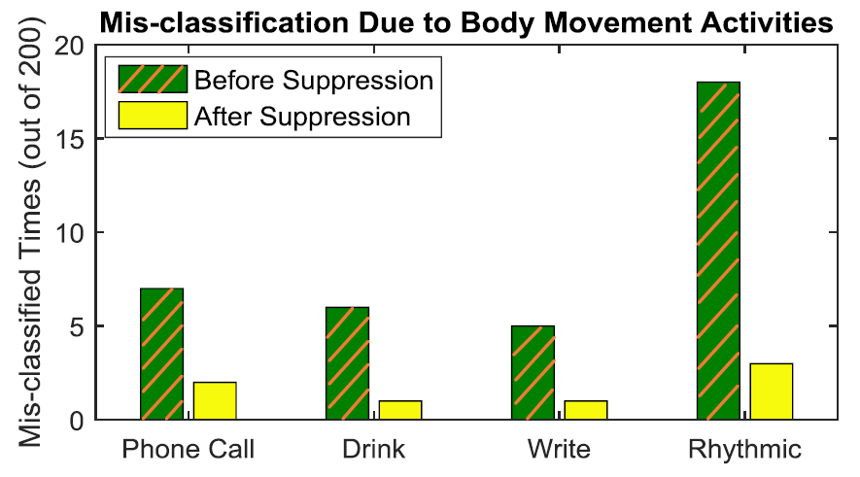

Slide 39

System Advantage
Unobtrusive/Non-contact
Hard to duplicate
Easy to deploy/use
Liveness
Notes:
Cardiac Scan possess some necessary properties. First, the Doppler radar can identify an authentic user in a non-contact and unobtrusive way so that the user has no obligation to change his/her behavior to adapt to the system. Second, it is highly secure and hard to duplicate or stolen. Cardiac motion is impossible to completely mimic or such information cannot be discloseed. Third, liveness detection, cardiac motion exists only in live user, so it can distinguish a real user or a replay attack. The last one is that cardiac scan is easy to deploy and use because it uses low cost and off the shelf components to build the radar sensor without expensive device.

Slide 40
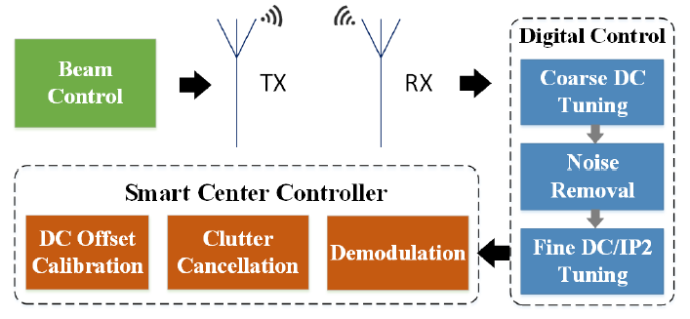
Challenge 1: Cardiac motion measurement by Doppler radar.
Notes:
First, how to design the front-end architecture of the Doppler radar to capture the cardiac motion pattern. To address this challenge, In receiver, we implemented the smart DC tuning including coarse and fine DC tuning that can dynamically adjust the amplifier bias to the desired level to allow the maximum dynamic range. In transmitter, the electronic beam control is implemented on the radar front-end to make the radar beam precisely point to the user’s chest.

Slide 41
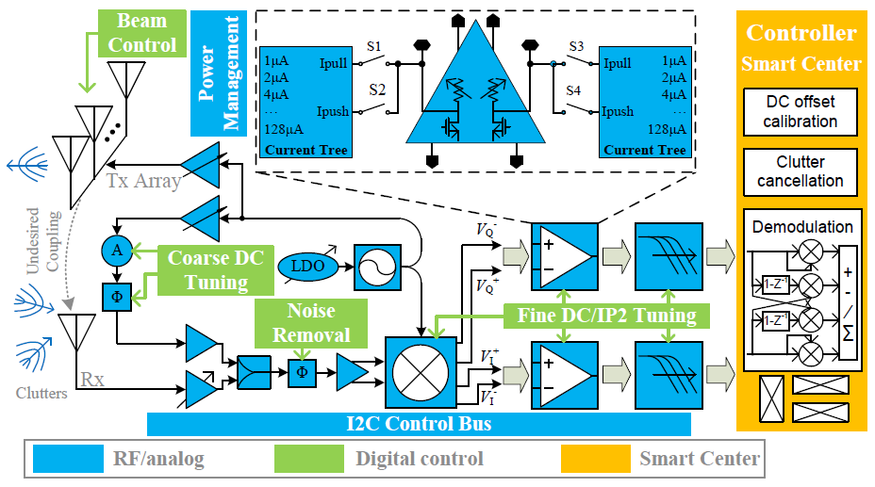

Slide 42
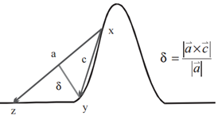
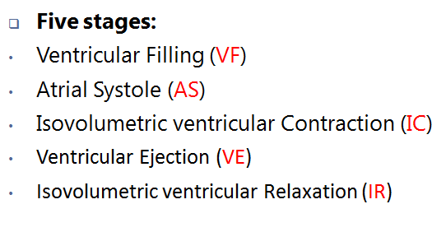
Maximizing δ to obtain max radius of curvature to find local extreme points
Inteference: The motion information to be detected is only a few Hertz, which means both received signals and transmitted signals are only separated by a few Hertz, while other signals from potential interferences (e.g., WiFi and Bluetooth) have a much higher frequency separation and are conveniently rejected by the baseband signals. In other words, both transmitted signals and received signals are “coherent", whereas other signals are not coherent with transmitted signals.

